Slide 1
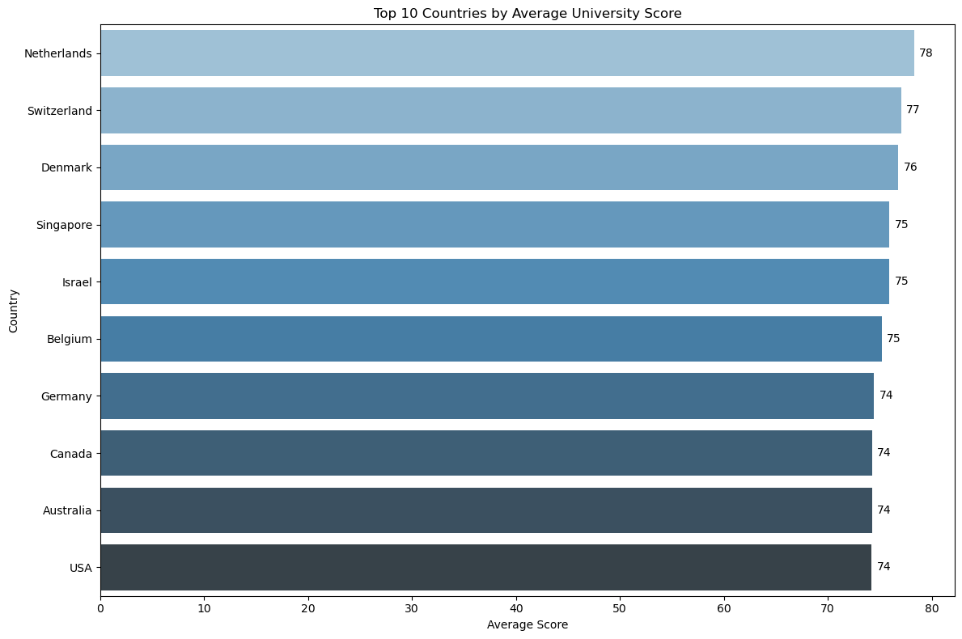
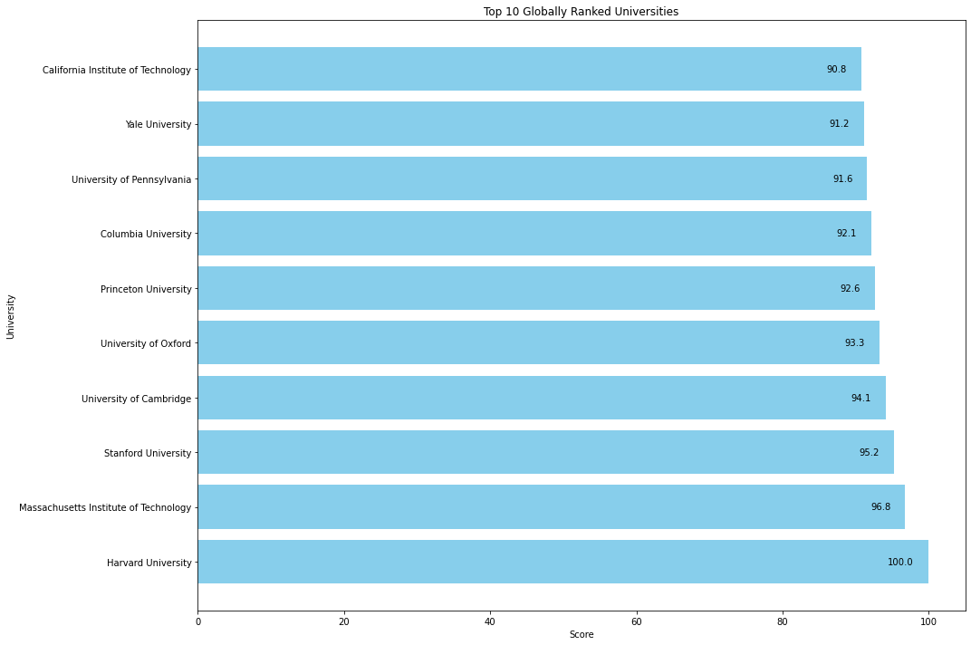

TOP 10 COUNTRIES BY AVERAGE UNIVERSITY SCORE:"
TOP 10
Top 10 Ranked universities

Slide 2
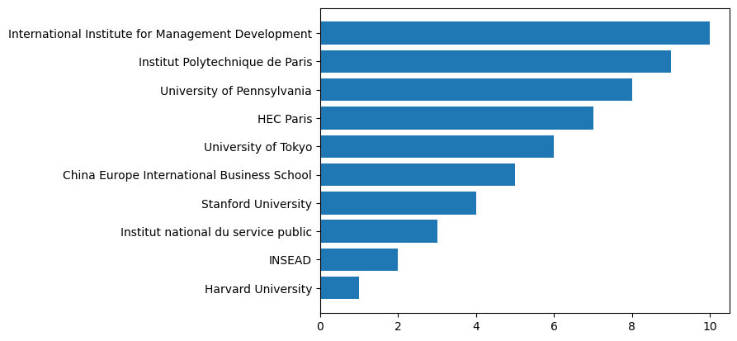
B. WHICH UNIVERSITIES ARE RANKED IN THE TOP 10 FOR EMPLOYMENT OUTCOMES?

Slide 3
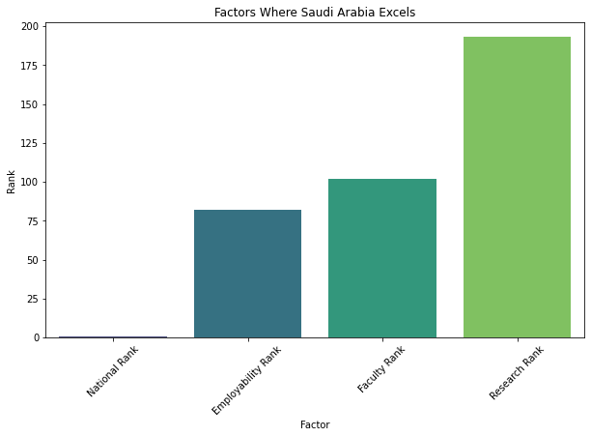
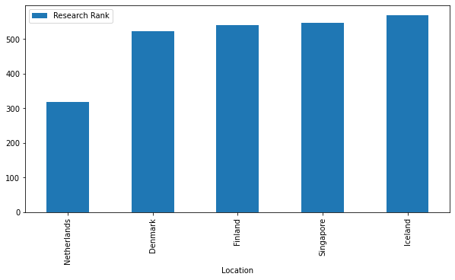
FACTORS WHERE SAUDI ARABIA EXCELS
TOP 5 AVERAGE RESEARCH

Slide 4
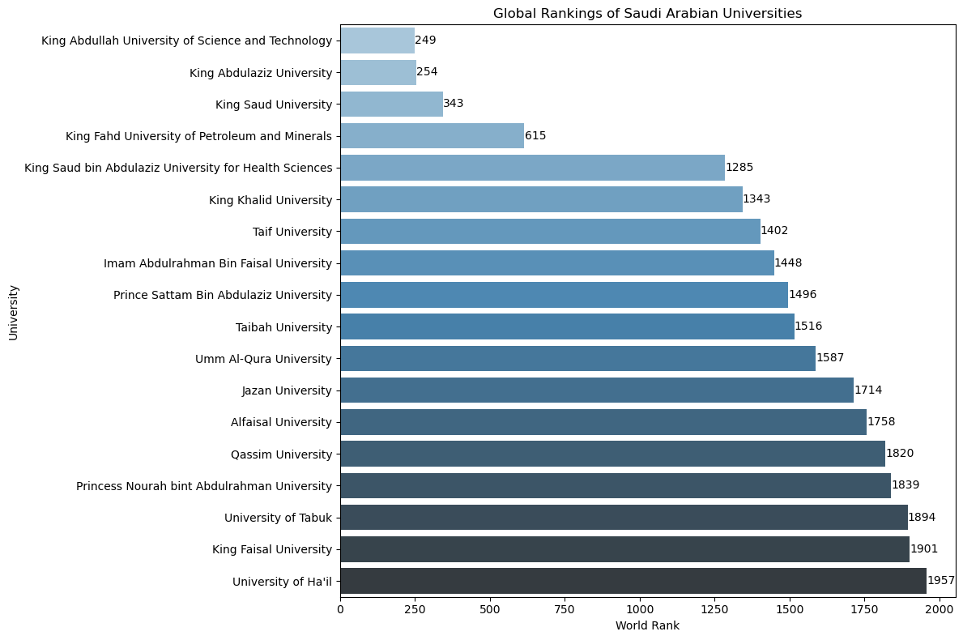
WHAT POSITIONS DO UNIVERSITIES IN SAUDI ARABIA HOLD WITHIN THE GLOBAL rankings?

